Slide 1
FAST BUSINESS TRAINING
Prepared for
ZapApp FAST Development Staff
March 2006
By Sana Ullah Khan

Slide 2
Agenda
Company Overview
Services offered by First American
First American business sources
How the business works
Regional business practices
Fees & Charges ~ what’s the difference?

Slide 3
Agenda - continued
Payment methods
Role of Brokers (real estate and mortgage)
HUD & Settlement Statements
Title & Escrow documents

Slide 4
COMPANY OVERVIEW
Based in Santa Ana, Ca – USA in 1889
Traded on the New York Stock Exchange as FAF
A Fortune 500 Company (ranked 300)
One of America’s most admired companies
A Technology Leader and eBusiness Innovator

Slide 5
SERVICES OFFERED
Title Insurance
Specialty Insurance
  Property & Casualty
  UCC
  Home Warranty
Trust & other services
  Banking Services
  Investment Management
  Trust Services

Slide 6
Services-continued
Mortgage information
  Credit Reporting
  Field Inspections
  Flood Determination
  Mortgage Document Services
  Online Commercial Evaluation
  Property Tax Consulting
  Tax Reporting (commercial & residential)

Slide 7
Services – continued
Property Information
  Appraisals
  Database Management
  Natural Hazard
  Property Information
  Title Plant
Credit Information

Slide 8
Services – continued
Automotive Information
  Vehicle title
Screening Information
  Driving records reporting
  Employee health programs
  Pre-Employment screening
  Resident screening
  Substance abuse management

Slide 9
TITLE INSURANCE
and
Escrow Services

Slide 10
Real Property vs. Personal Property
Real Property: Land& the buildings affixed to the land, including air space above and mineral rights below.
Personal Property: Moveable property-all property which is not real property.

Slide 11
What is “title”?
Evidence of a person’s right or the extent of his interest in real property
First American has many ‘products’ which provide this evidence depending on the type of property, type of transaction and on whose behalf the insurance product is being issued

Slide 12
What does Title Insurance provide?
Insures a new owner (buyer) that the person selling the property is the rightful owner with the full power and capacity to sell
Insures a new lender that the person borrowing money and using the property as security for that loan is the rightful owner of the property
Insures all parties that the property is free & clear of any liens, encumbrances or restrictions that might affect the property in a negative manner

Slide 13
What is “escrow”?
A third party ‘clearing house’ for funds and documents pending delivery upon the performance of specific conditions
The ‘third party’ is referred to as the “Escrow Holder”

Slide 14
Reasons for having an escrow:
“Escrow Holder” serves as a neutral / third party and has a dual agency responsibility representing both sides to a transaction
Using an escrow assures all parties that the conditions of the transaction will be met before the transaction is consummated
Since all funds and documents are held by the “Escrow Holder” it provides a form of consumer protection

Slide 15
What is “Sub-Escrow”?
A Sub Escrow transaction is an order where an Outside Escrow Company provides escrow services to a borrower (for a Refinance or Loan transaction) or to a buyer and seller (for a Sale or Exchange transaction), and the First American office provides title services and products directly to the Outside Escrow Company. The user selects Title and Sub Escrow as the service types. Funds from the New Loan Lender and/or the Outside Escrow Company are receipted into the file, using the file’s Title Owning Office’s bank account. Loan payoffs, miscellaneous disbursements, and fees for title services are disbursed from the Title Owning Office’s account.
In some areas, the Sub Escrow service will be used for transactions where the First American office acts as a disbursement agent and provides only disbursement services to the Outside Escrow Company. In these cases the First American office does not provide escrow services or provide any title work or title insurance products, but needs to send a Disbursement Statement to the Outside Title Company as a record of deposits and disbursements in the file. The user selects Escrow and Sub Escrow as the service types, and the file’s Escrow Owning Office’s accounts are used for the deposits and disbursements

Slide 16
What is a mortgage?
Another part of our business is set up to meet the needs of the Real Estate industry which is the Mortgage or Lending business
Banks participate in the US economy by lending money to those who want to buy real estate.
Interest for the use of this money is charged to the borrower and the lender’s investment is secured further by making the property ‘collateral’ for the loan

Slide 17

We are in the business of SERVICE
We aren’t building anything
We provide a service to those who want to own their own home or who want to invest in real property
We provide a means by which people can achieve their goals of owning real property
We must provide this service in a pleasant and professional manner efficiently and economically

Slide 18
The source of our business
Lenders
Mortgage Brokers
Real Estate Brokers / Agents
Buyers
Sellers

Slide 19
How does this equate to FAST?
In the FAST system we refer to
  Business Segments
  Transaction Types
  Service Types

Slide 20
BUSINESS SEGMENTS
Residential
Commercial
New Homes/Subdivision
Default
Time Share

Slide 21
TRANSACTION TYPES
Accomodation
Bulk Sale
Construction Loan
Equity Loan
Foreclosure
Refinance
REO (real estate owned)
Sale with Cash
Sale with Exchange
Sale with Mortgage
Search Package
Sub-Escrow
NOTE: The most common types of transactions are Sale & Refinance

Slide 22
SERVICE TYPES
Title
Escrow
Sub Escrow

Slide 23

HOW THE BUSINESS WORKS

Slide 24
Sale and Refinance transactions
The processing structure and principals involved in each are different.
Principals to a Sale: Principals to a Refinance:
Buyer Borrower
Seller Lender / Mortgage Broker
Parties to a Sale: Parties to a Refinance:
Real Estate Broker/Agent
Title Company Title Company
Insurance Company Insurance Company
Existing Lender/Lien holders Existing lender/Lien holders
New Lender New Lender
Mortgage Broker Mortgage Broker
Attorneys – if applicable Attorney’s - if applicable
Inspection Companies
Misc. Creditors Misc. Creditors

Slide 25
REGIONAL BUSINESS PRACTICES AND WORKFLOW
Western US – Escrow States
Eastern & Midwest US – Closing States

Slide 26
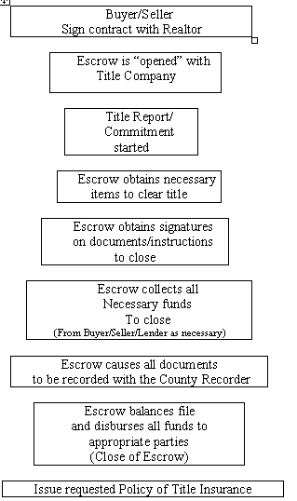
General Overview of a typical “SALE” transaction (Western/Escrow Style)

Slide 27
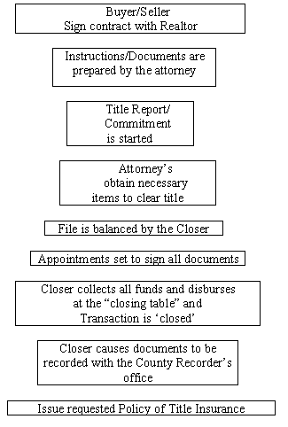
General Overview of a typical “SALE” transaction (Eastern / Closing Style)

Slide 28
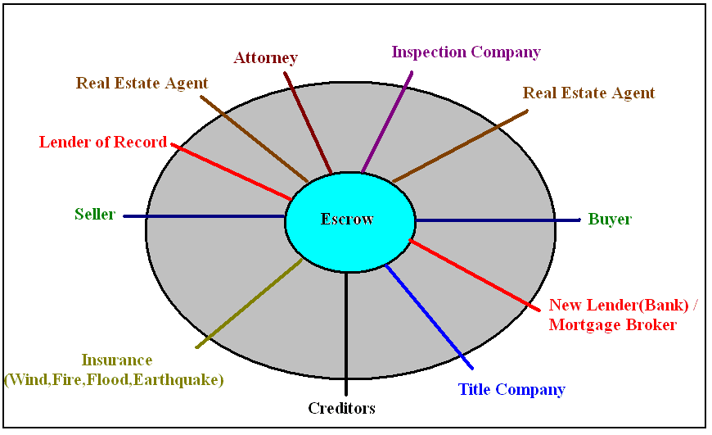
TITLE INSURANCE and
Escrow Services

Slide 29
Fees vs. Charges
What is the difference?
Fees:
Fees are those charges which are collected through the file that are
payable to First American for title and escrow services or to reimburse for
amounts advanced during the course of the transaction by First American
Title and Escrow
  Fees for title insurance products and premiums
  Fees for escrow services
  Miscellaneous fees
Recording and Tax
  Fees for recording with the county recorder documents in connection with the transaction
  State, County and/or City transfer taxes
  Miscellaneous taxes

Slide 30
Fees vs. Charges
What is the difference? Contd..
Charges:
  Charges are those expenses paid to entities other than First American.
  Some examples of charges would be:
  Termite Inspection
  Insurance premiums (not title insurance) – rather homeowners, wind, earthquake, flood etc.
  Misc. bills for payment of unsecured liens (credit cards etc.)
  Real Estate Broker commissions
  New Lender
  Payoff Lender
  Attorney
  Home Warranty
  Surveys
  Utilities
  Etc. etc.

Slide 31
PAYMENT METHODS
POC – Paid outside of Closing
POC-B – Paid outside of Closing by Buyer
POC-L – Paid outside of Closing by Lender
POC-MB – Paid outside of Closing by Mortgage Broker
POC-S – Paid outside of Closing by Seller
RBL – Retained by Lender
  This is the most common selection and most regions have their payment method for the new lender default to this method.
  By selecting this method the system will automatically deduct the charge from the total amount of the new loan as part of figuring the “net proceeds” or amount the lender will fund to the escrow at closing

Slide 32
WHAT IS A HUD?
In the United States the government has regulated the manner in which fees, charges and adjustments are accounted for and disclosed to a Buyer, Seller and/or Lender in a real estate transaction involving a single family or 1-4 multi-family property where a government backed loan is part of the transaction.
The law, which regulates this process, is referred to as RESPA
(Real Estate Settlement Procedures Act).
The format for disclosing these fees and charges is referred to as a HUD-1 or HUD-1A.

Slide 33
WHAT IS A HUD? Contd…
HUD-1 – form used for the purchase/sale of real property as described above
HUD-1A – form used for a loan to a borrower, which does not involve the sale of real property. (i.e.: A refinance or loan escrow). Although this form is to be used for a loan / refinance settlement transaction it is acceptable to use the HUD-1 form as well. However, a HUD-1A form cannot be used for a sale transaction.
Both formats of the HUD are to be completed by the Settlement Agent (Escrow Officer/Closer)
The FAST system has been designed to automatically fill in the appropriate HUD line based on its input into the FAST source screen.

Slide 34
THE ROLE OF THE
REAL ESTATE BROKER
BROKER:
    Licensed by the State in which they are doing business.
    Licensing requirements are more stringent than those for Real Estate Agents.
    The Broker is responsible for real estate agents working under them.
    Commissions can ONLY be paid to a Real Estate Broker, although the Broker may authorize escrow to pay the Agent directly through the closing. Without this authorization no commissions can ever be paid to an Agent.

Slide 35
THE ROLE OF THE
REAL ESTATE BROKER
AGENT:
    Licensed by the State in which they are doing business.
    A Real Estate Agent cannot receive payment for commission without the express authorization of the Real Estate Broker with whom they have their license.

Slide 36
THE ROLE OF THE
REAL ESTATE BROKER
Real Estate Brokers and Agents work directly with the Buyers and Sellers in the real estate process.
Some Brokers/Agents deal exclusively with the listing of a property for sale and work mainly with Sellers of real property.
Some Brokers/Agents deal exclusively with Buyers in locating and purchasing real property.
Some Brokers/Agents work with both Buyers and Sellers representing them in either the sale and/or purchase of real property. When this happens they are known to have a ‘dual agency’ obligation.
The Broker/Agent will work directly with the Escrow and/or Attorney (in the Eastern states) to coordinate and assist in the successful closing of the real estate transaction. Local custom generally dictates the manner and level of involvement the Broker/Agent has with the details of the escrow/closing.

Slide 37
Thank You
Questions?

